Slide 1
Report for Community Council
29th November 2021 – 21st January 2022

Slide 2
Numbers
Number of Young People worked with - 423
Number of Activities - 72
Number of Learning Hours – 627

Slide 3
Junior Youth Café
Weekly sessions of fun had by everyone
Before Christmas – lots of Christmas crafts for young people to take home to parents / guardians.
Refreshments are served at every activity.
Containing, selection of fruit, sandwiches, and home baking.
The juniors have created their own code of conduct, along with monthly fire drills and so all young people know what to do in the event of a fire.

Slide 4
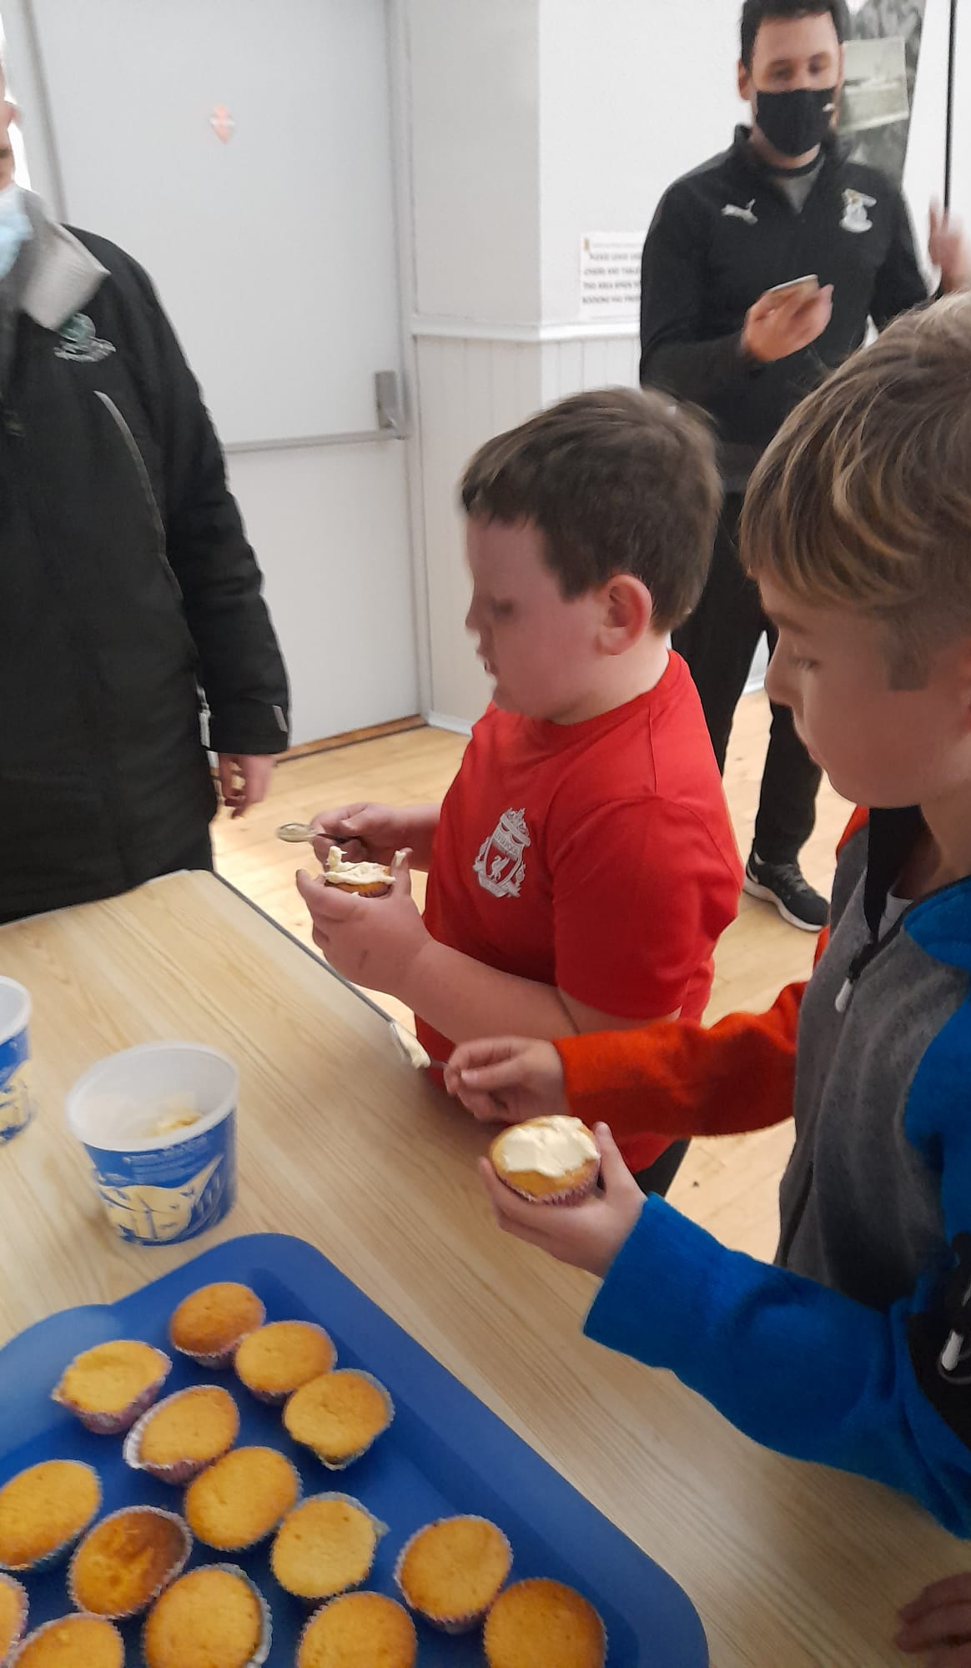
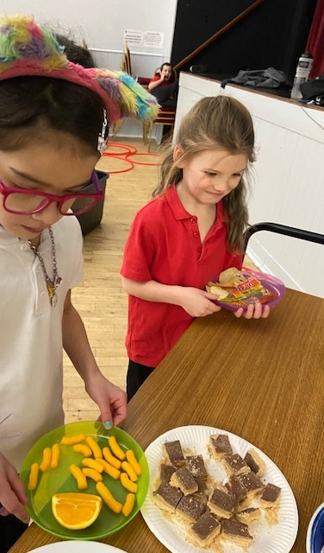
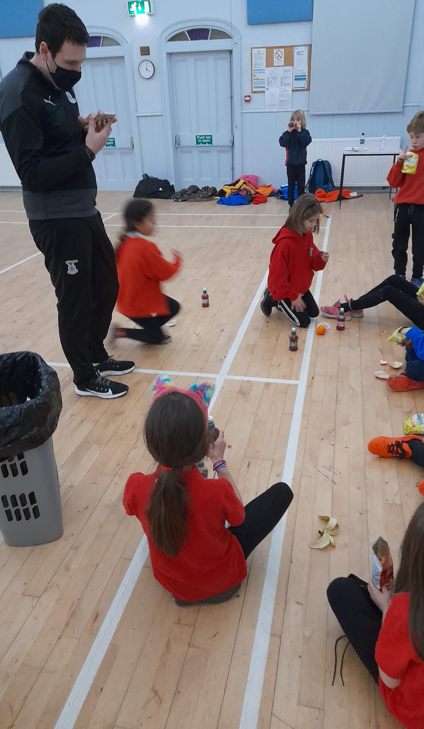

Slide 5
Badminton
Badminton coaching sessions happening weekly.
Young people are improving each week
Lots of conversations about well-being when young people are sitting at the side waiting to play.

Slide 6
Football Coaching with Inverness Caley Thistle
This term we are looking at literacy in football and how to be come good communicator, as communication is a huge part of team work, and team work is needed for football.
The first week the coaches ask the young people to create their own superhero with super powers needed to be a footballer.
The following week we played Descriptionary – the young people wrote down a word and then had to use their communication skills to describe the word in 10 clues or less.
Each session is finished with young people focusing on a skill, it could be passing, dribbling, scoring
The young people are gaining new skills each week. I know this as I am seeing an improvement and the coaches have told me.

Slide 7
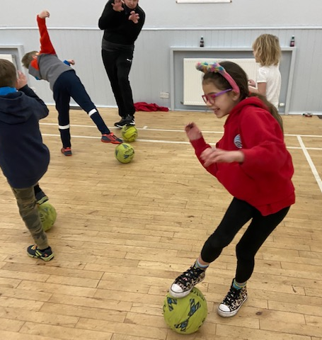
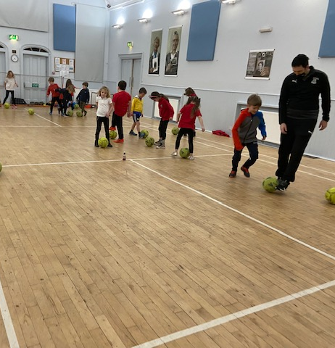
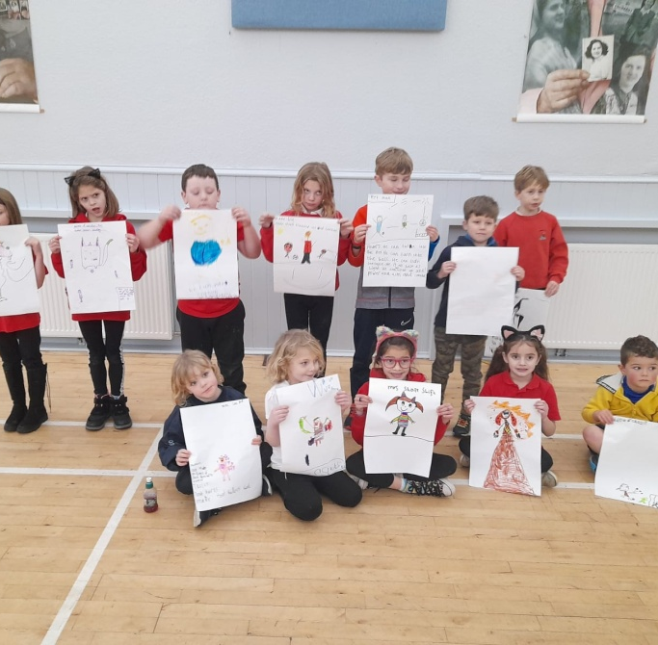

Slide 8
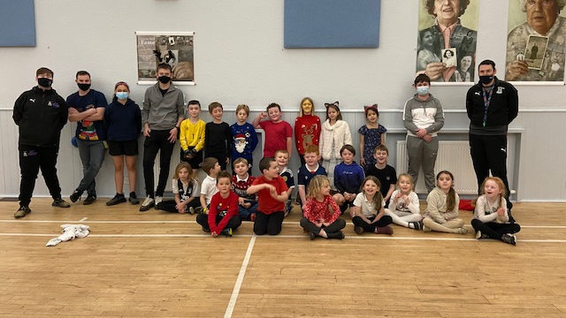

Slide 9
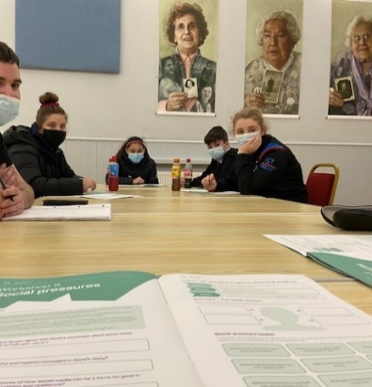
Resilience in Your Community
I have been co-delivering this with Liz Newstead from Support In Mind Scotland – this has been really good for my own personal development
We have been taking part in Your Resilience, as we passionately believe in supporting all young people by offering them the necessary tools and knowledge for maintaining good mental health through life’s transitions. Our young people recognise the importance of their mental health and resilience and were keen to take part. To gain a better understanding about resilience and what it means.
Young people told us that they valued the resilience workshops which allowed them to discuss their thoughts and feelings in their safe space.
“The greatest weapon against is stress is our ability to choose one thought over another”

Slide 10
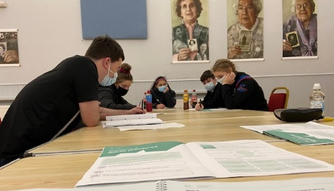
Resilience in Your Community continued
The course covered:
What is Resilience
Exam Stress
Managing Studies
Making Decisions about the Future.
Social Pressures
Friendship
The Project Aims were to:
Develop a deep awareness of Resilience and its importance
Deepen young people’s self-awareness of how the characteristics and strengths of resilience relate to themselves
Understand the approaches and techniques that young people can use to improve their resilience
Have more awareness of the mental health needs of others
Feel more equipped to deal with challenges in life
Deepen young people’s awareness of who they can turn to for support

Slide 11
Christmas Cheer
We held our annual Christmas party for the Juniors,
Lots of fun had by everyone, played lots of party games and did lots of dancing
Huge thank you to Ethan Paterson for creating the young people individual snack boxes filled with a range of homemade Sandwiches, Homemade Shortbread, Candy Canes, Crisps, Chocolate Coins, fruit
Everyone received a Selection Box donated from either Tesco or Morrisons and an SPFL Football Sticker Book from Inverness Caley Thistle

Slide 12
Participation Forums
Over the last few month Young people have attended these meeting:
Cromarty & District Community Council x 2 Youth Reps attending pre meeting to discuss items to be brought up at the main meeting
Cromarty Community Rowing Club x 2 snr youth reps & x3 jnrs reps who are being trained up for when the snr move on.
Highland Youth Parliament x2 Youth Reps
Northern Alliance x 1 Youth Rep

Slide 13
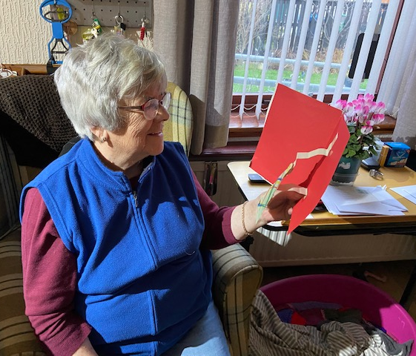
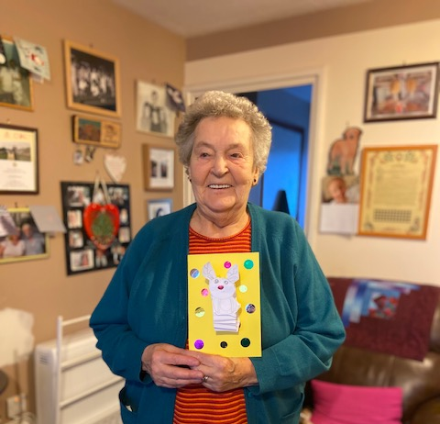
Christmas Card Deliveries
In Partnership with Cromarty Primary School, pupils hand made Christmas cards for older people in Cromarty
Myself and Wanda then socially distanced hand delivered these cards

Slide 14
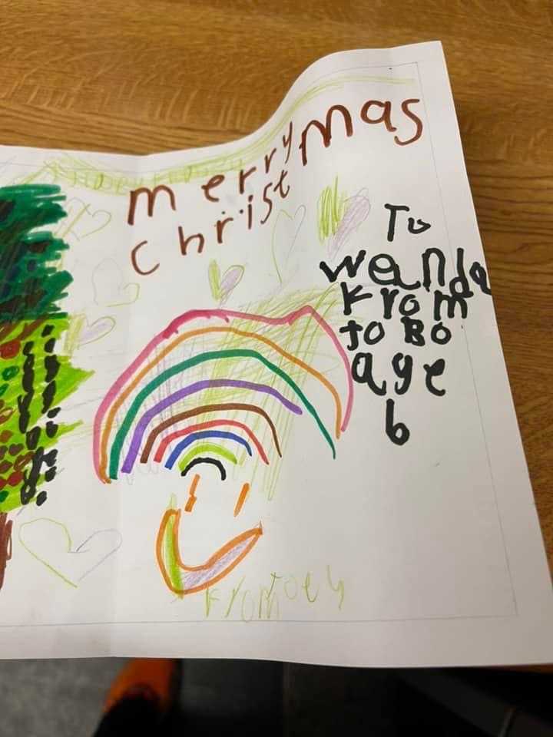
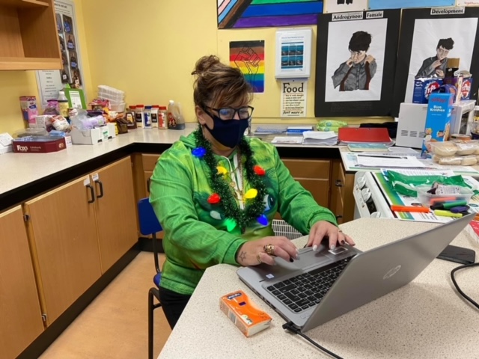

Slide 15
Helping hands at Christmas
26 young people received sack of presents from MFR Cash for kids
Families received vouchers from MFR Emergency Grant Application for Shopping vouchers, Electric Vouchers and or Amazon Vouchers
Huge thank you to Estelle from the Cromarty Post Office for Supporting with the electric vouchers.
6 families received Aldi Vouchers from the Salvation Army
We held a Christmas Jumper fundraiser in Fortrose Academy to Raise funds for MFR Cash for Kids Missions Christmas this raised £207.07

Slide 16
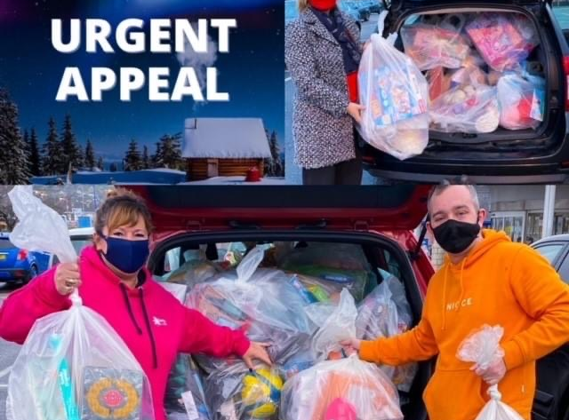

Slide 17
Multi-Sports
Every Monday nights this is led by Young leaders
Young leaders plan , deliver and then review the session
The plan is always delivered around what young people want,
Lots of new skills have been learned by the young people, especially how to play badminton.

Slide 18
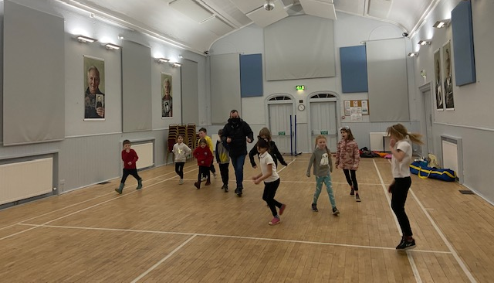
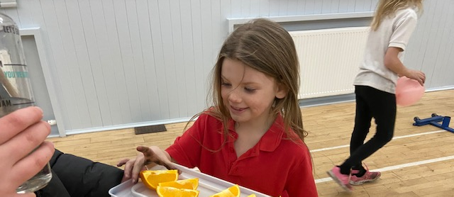
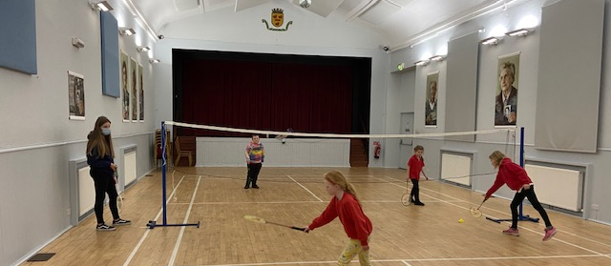

Slide 19
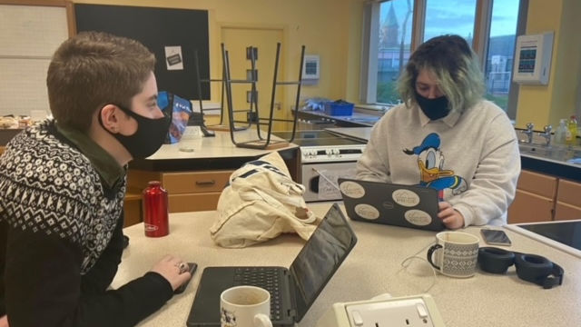
Equalities Steering Group
Working weekly with the steering group,
Over last few weeks we have been collating the information from the whole school survey, now working on an action plan.

Slide 20
1-1’s
Lots of 1-1’s happening this month,
Lots of young people had more fears around COVID and ever-changing guidelines, or fearing about having to isolate over Christmas and not being able to see friends or family
Young people stressing up till now over prelims and assessments
Some young people are stressing about learning to drive and the cost of it,
Supporting young people to take part in online training with CALA,
Supporting YP to write college application.
Giving young people a safe space to talk to a trusted adult.

Slide 21
Cookwell / Bakewell
During December Young people have been cooking / baking for older people in the community,
Myself and Wanda have done doorstep deliveries with baked goodies such as, Shortbread, Tea Loafs and Gingerbread
This was on the Back of Partnership with the Black Isle Cares, and all older people receiving care received a Takeaway St Andrews Afternoon Tea, all prepared by young people

Slide 22
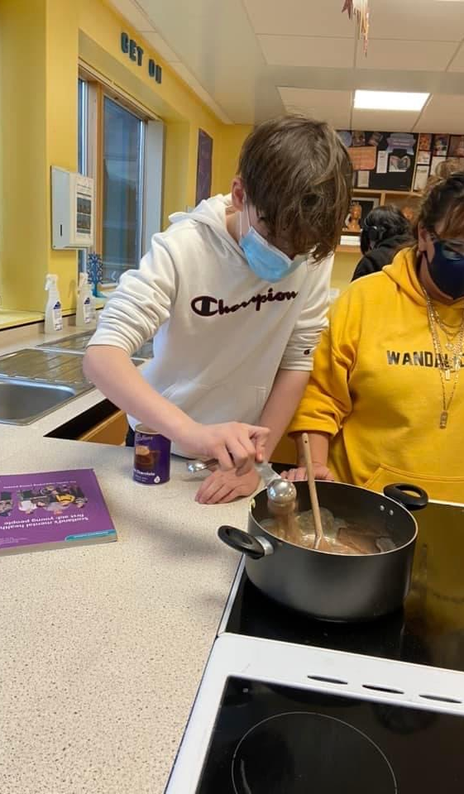
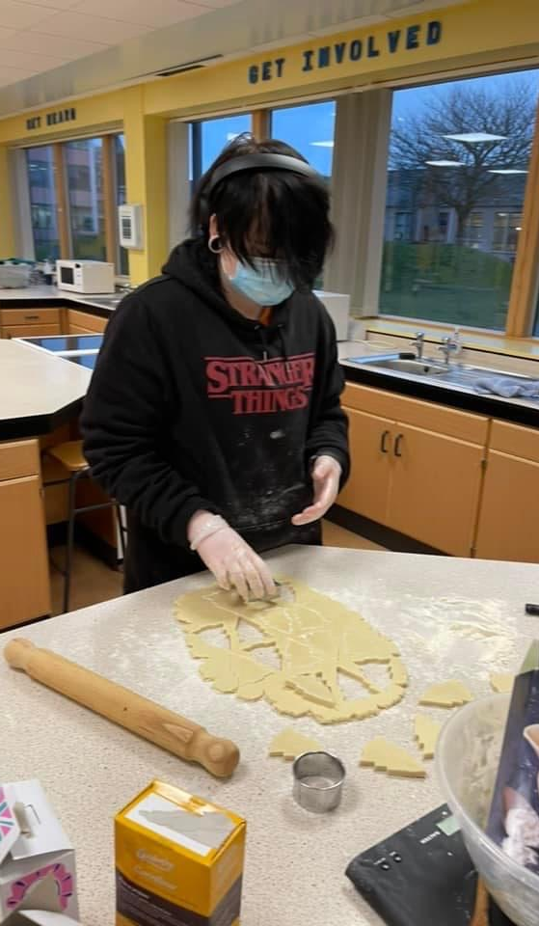
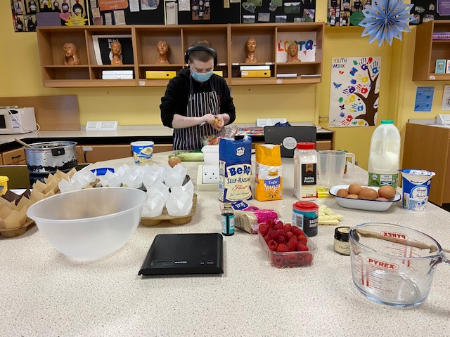
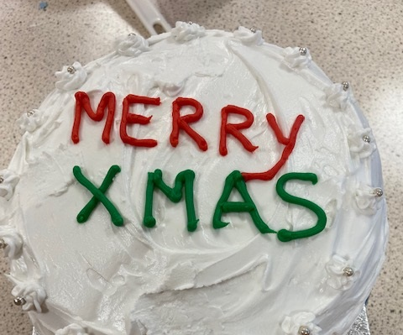

Slide 23
Staff Development
Myself and Wanda have now completed our International Diploma in Intergenerational Learning with the University of Granada
John Munro Completed his Children Affected by Parental Substance Misuse

Slide 24
Meeting’s
Over the couple months there has been lots of background planning work going on:
Wanda had a meeting with the Black Isle Youth Football Club – Looking at setting up a girls football club
Velocity Bike Repair – Looking at delivering Bike Ability to young people across the Black Isle
Meeting Active Schools to discuss Choose to Lead Level 4 for the young leaders and planning summer 2022
Meeting with Outdoor Education to plan summer 2022
Meeting with Siobhan at the Highland Hospice to look at a new course called International Last Aid – training around removing the stigma of death.
Meeting with Mike Sutherland Development worker Highlands and Islands form CFINE about Tackling food Poverty Together

Slide 25
Wider Achievement
Two young volunteers who support Cromarty Youth Café were awarded Saltire Summit Awards for Outstanding Contribution to Volunteering – Tilly Grist & Amy Harrison
Kyle Cameron from Fortrose was presented his 500 hours High Life Highland Leadership Awards from the Lord Lieutenant, Kyle has been leading at many different projects, Kyle Starting his piping journey with the Cromarty Chanter Class. Kyle was asked to pipe at the Intern of Henry Ashes (The gentlemen who donated the funding to set up the Middleton Trust)
Young people are continuing to work on Saltire and HLH Leadership programme, and Tracking and monitoring taking place weekly
Head Teachers Award from Fortrose Academy – Ethan Paterson for his outstanding contribution for Fortrose Academy & The Youth Work Department

Slide 26
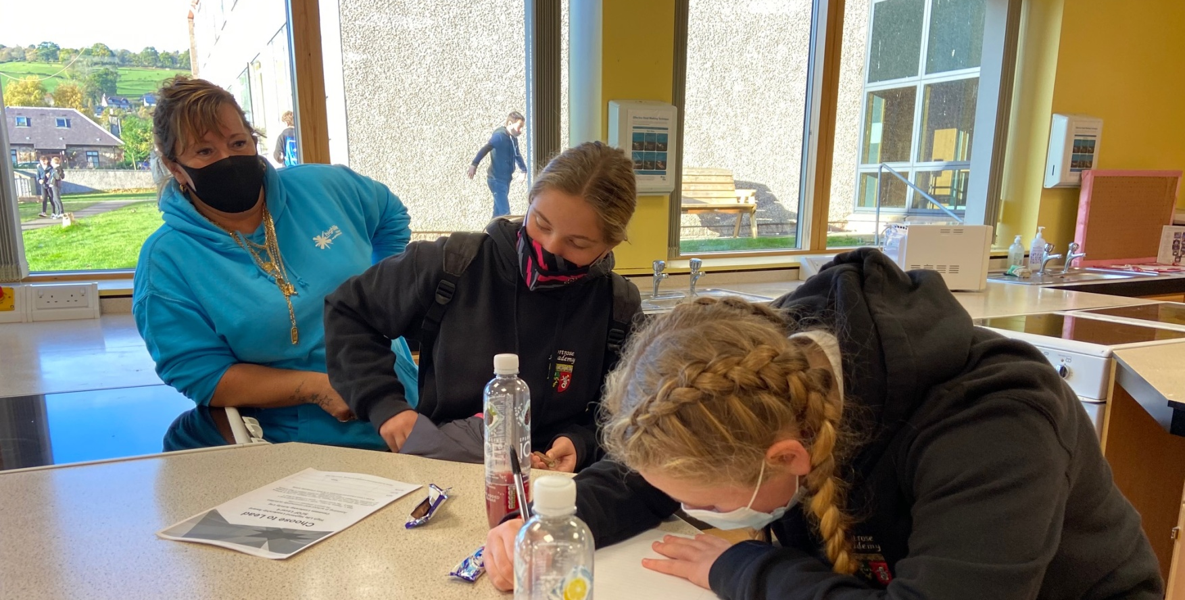
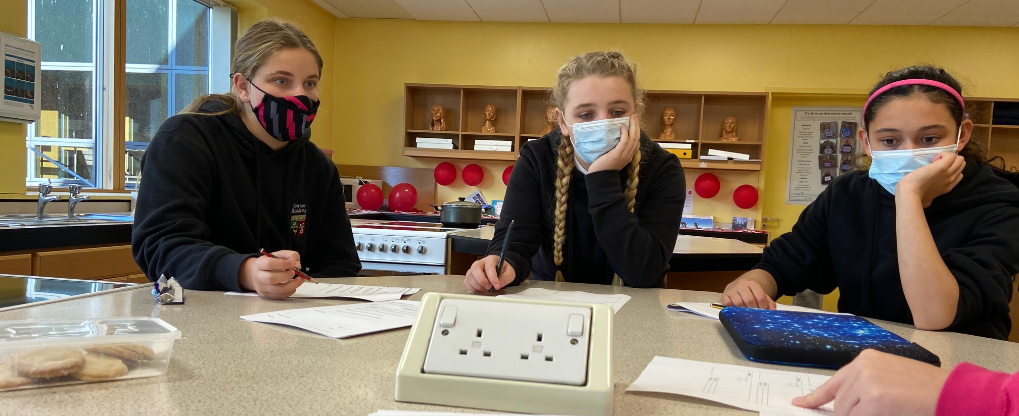
Wider Achievement
Young People are taking part in High Life Highland Choose to Lead Level 4 certificated course
Varoious different courses on the Virtual College
Various different courses on CALA E-Learning

Slide 27
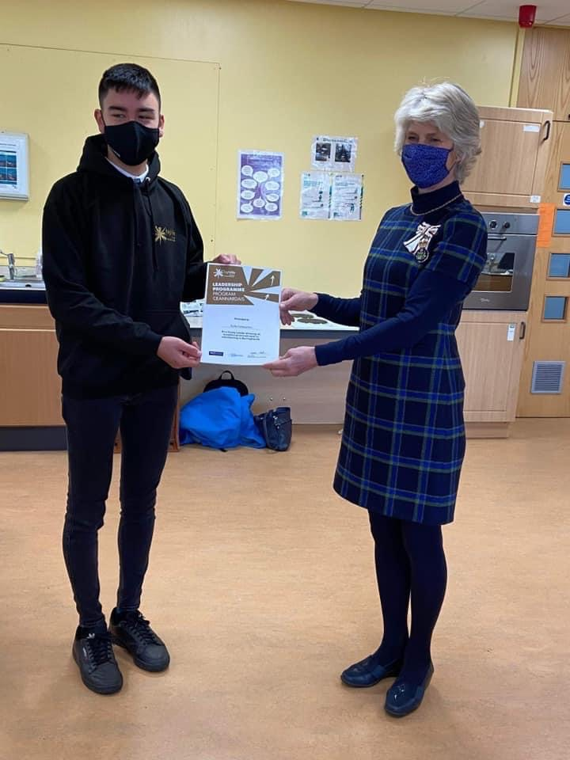
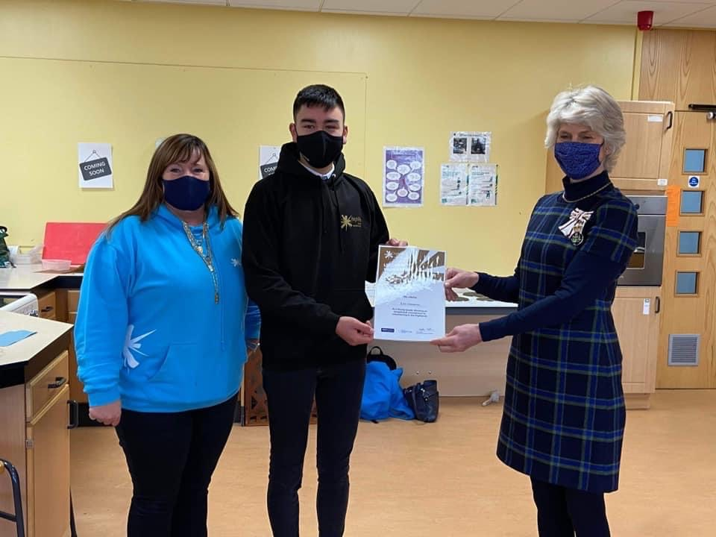

Slide 28
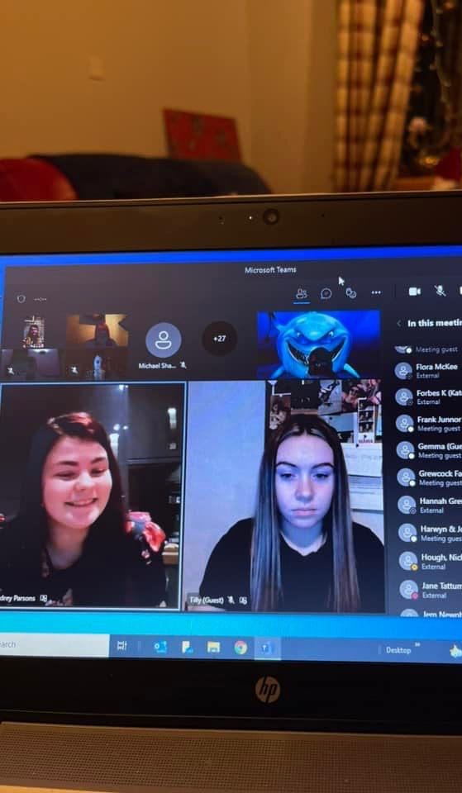
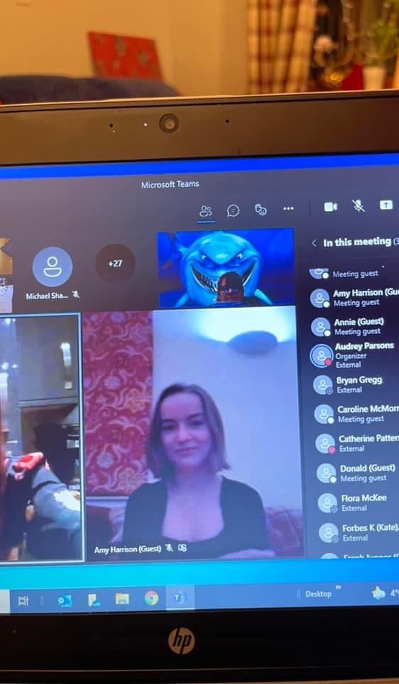

Slide 29
Indoor Rowing
Weekly Indoor rowing sessions
Working in improving timing and techniques
Taking part in time trials – 250m, 500m and 1K
All the young people times are improving weekly.

Slide 30
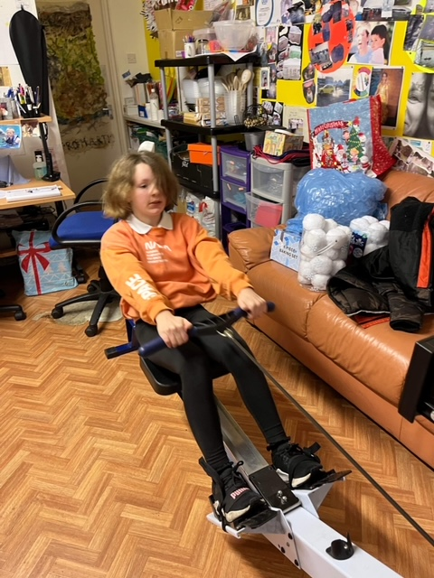
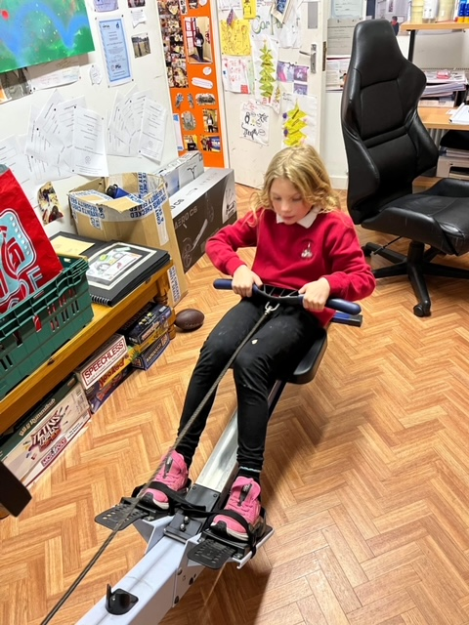
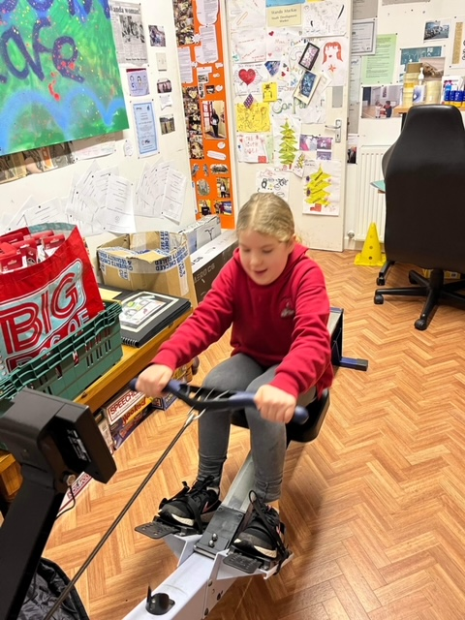
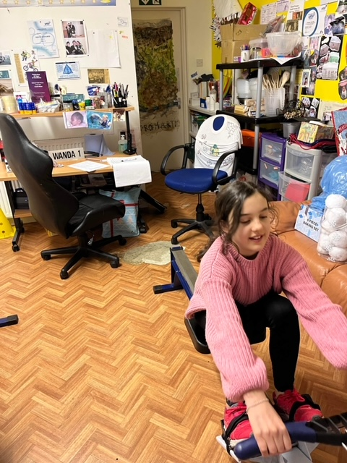

Slide 31
Funding Biggest Thank you to Wanda for doing these
Application done to the Black Isle Ward Place Based fund for activities throughout 2022
MFR Cash for Kids – Holiday hunger & Cookwell / Bakewell
Letter to Hugh Fraser Foundation
Two applications done to Youth Scotland Big Ideas Fund
one application pending – for a young person to host a bake sale
Other application successful – for Adam Urquhart to created seasonal garden ornaments , Christmas’s Snowmen done and sold before Christmas

Slide 32
